Slide 1

INSIGHTS OF INSTAGRAM USER ANALYTICS :- BY SACHIN THAKUR

Slide 2
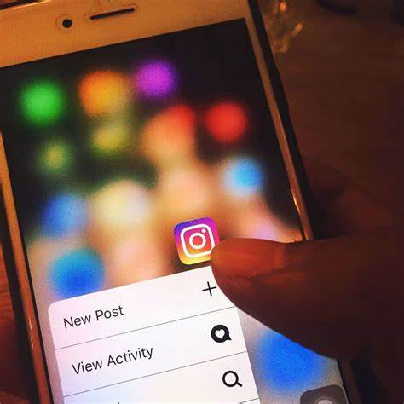
CONTENT
1. INTRODUCTION
2. INSTAGRAM
A - MARKETING ANALYSIS
B - INVESTOR MATRICS
3 . OVERVIEW OF ANALYSIS

Slide 3
INTRODUCTION
IN THIS ANALYSIS WE ARE GONNA GIVE A BRIEF STUDY ABOUT THE MARKETING ANALYTICS AND INVESTOR MATRICES OF INSTAGRAM USER ANALYTICS AND HELP’S TO MAKE DECISIONS BASED ON THIS REPORT .

Slide 4
A. MARKETING ANALYSIS
SOLUTIONS FOR THE FOLLOWING QURIES BY USING SQL
1. Rewarding Most Loyal User : Task: Find the 5 oldest users of the Instagram from the database provided .
2. Remind Inactive Users to Start Posting : Task: Find the users who have never posted a single photo on Instagram .
3. Declaring Contest Winner : Task: Identify the winner of the contest and provide their details to the team .
4. Hashtag Researching : Task: Identify and suggest the top 5 most commonly used hashtags on the platform .
5 . Launch AD Campaign : Task: What day of the week do most users register on? Provide insights on when to schedule an ad campaign

Slide 5
B. INVESTOR MATRICES
1. User Engagement : Task: Provide how many times does average user posts on Instagram. Also, provide the total number of photos on Instagram/total number of users .
2. Bots & Fake Accounts : Task: Provide data on users (bots) who have liked every single photo on the site (since any normal user would not be able to do this).

Slide 6
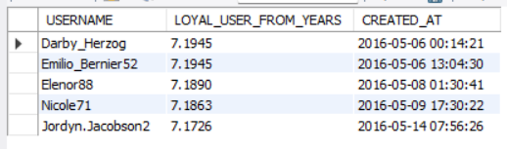
MOST LOYAL USERS OF INSTAGRAM
SQL CODE : SELECT USERNAME , (DATEDIFF(NOW(),CREATED_AT)/365) AS LOYAL_USER_FROM_YEARS , CREATED_AT FROM USERS ORDER BY CREATED_AT ASC LIMIT 5 ;
USER NAME | USER FROM ( IN YEARS) | CREATED AT (YYYY-MM-DD)
1.DARY_HERZOG | 7 | 2016-05-06
2.EMILO_BERNIER52 | 7 | 2016-05-06
3.ELENOR88 | 7 | 2016-05-08
4.NICOLE71 | 7 | 2016-05-09
5.JORDYN.JACOBSAN 2 | 7 | 2016-05-14

Slide 7
INACTIVE USERS OF INSTAGRAM
THE INACTIVE USERS OF INSTAGRAM ARE GIVEN WITH THEIR ID’S AND USERNAME’S BELOW :
SQL CODE : SELECT ID , USERNAME FROM USERS WHERE ID NOT IN (SELECT DISTINCT USER_ID FROM PHOTOS ) ;
ID | USERNAME
5 | Aniya_Hackett
7 | Kasandra_Homenick
14 | Jaclyn81
21 | Rocio33
24 | Maxwell.Halvorson
25 | Tierra.Trantow
34 | Pearl7
36 | Ollie_Ledner37
41 | Mckenna17
45 | David.Osinski47
49 | Morgan.Kassulke
53 | Linnea59
54 | Duane60
57 | Julien_Schmidt
66 | Mike.Auer39
68 | Franco_Keebler64
71 | Nia_Haag
74 | Hulda.Macejkovic
75 | Leslie67
76 | Janelle.Nikolaus81
80 | Darby_Herzog
81 | Esther.Zulauf61
83 | Bartholome.Bernhard
89 | Jessyca_West
90 | Esmeralda.Mraz57
91 | Bethany20

Slide 8
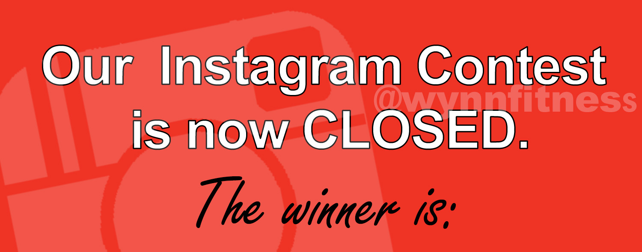
DECLARING THE WINNER OF THE CONTEST
THE CONTESTANT WHO GOT THE MOST NUMBER OF LIKES AND WON THE COMPETATION IS
Eveline
SQL CODE : SELECT USERS.ID , USERS.USERNAME , COUNT(LIKES.USER_ID) AS LIKES FROM USERS INNER JOIN PHOTOS ON PHOTOS.USER_ID = USERS.IDINNER JOIN LIKES ON PHOTOS.ID = LIKES.USER_ID GROUP BY USERS.ID , USERS.USERNAME ORDER BY LIKES DESC LIMIT 1 ;

Slide 9
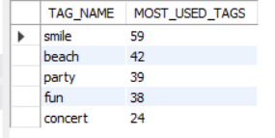
TOP 5 MOST COMMONLY USED HASHTAGS
SQL CODE : SELECT TAG_NAME , COUNT(ID) AS MOST_USED_TAGS FROM TAGS JOIN PHOTO_TAGS ON PHOTO_TAGS.TAG_ID = TAGS.ID GROUP BY TAG_NAME ORDER BY MOST_USED_TAGS DESC LIMIT 5;
USERNAME | NUMBER OF TIMES USED
SMILE | 59
2. BEACH | 42
3. PARTY | 39
4. FUN | 38
5. CONCERT | 24

Slide 10

WHICH DAY MOST USERS REGISTERED
SQL CODE : SELECT DAYNAME(CREATED_AT) AS DAY_NAME , COUNT(DAYNAME(CREATED_AT)) AS NUMBER_OF_REGISTERED FROM USERS GROUP BY DAY_NAME ORDER BY NUMBER_OF_REGISTERED DESC LIMIT 2;
THE MOST NUMBER OF USERS REGISTERED ON WHICH
DAY OF THE WEEK ARE :
DAY_NAME | NUMBER OF REGISTERED
THURSDAY | 16
SUNDAY | 16

Slide 11

HOW MANY TIMES DOES AN AVERAGE USER POST ON INSTAGRAM
SQL CODE : SELECT COUNT(DISTINCT USER_ID) AS TOTAL_USERS , COUNT(IMAGE_URL) AS TOTAL_PHOTOS , COUNT(IMAGE_URL)/COUNT(DISTINCT USER_ID) AS AVG_USER_POSTS FROM PHOTOS ;
THERE ARE TOTAL 74 USERS WHO POSTS THE PHOTOS REGULARLY ON THEIR INSTA HANDLE.
TOTAL NUMBER OF PHOTOS POSTED BY USER’S ARE 257 PHOTO’S
THE AVERAGE USER’S PER POST IS = 3.4

Slide 12
BOTS AND FAKE ACCOUNT
SQL CODE : SELECT USER_ID FROM LIKES GROUP BY USER_ID HAVING COUNT(DISTINCT PHOTO_ID ) = ( SELECT COUNT(*) FROM PHOTOS ) ;
THE USER WITH EACH LIKE ON EVERY PHOTO IS CONSIDERED AS BOT .
WE HAVE 13 USER’S ID WHO SATISFY THE CRITERIA THEY ARE :
5 ,14 , 21 , 24 , 36 , 41 , 54 , 57 , 66 , 71 ,
75 , 76 , 91 .

Slide 13
OVERVIEW OF THE ANALYSIS
I PERFORMED THE MOST PART OF THE PROJECT BY USING MYSQL FROM EXTRACTING THE DATA TO FINALLY SOLVING THE QURIES.
BY SOLVING THE I HELPED ME HOW THE DATA IS GETTING HANDLED AND MANIPULATED IN OUR CONVINENT WAY TO GET THE OUTCOME THAT WE REQUIRE .
IT DETAIL REPORT HELPS US FOLLOW THE LOOP HOLES WHERE THE APP NEEDS TO WORK ON LIKE DECLARING UP WINNER OF THE CONTEST AND SENDING REMINDERS TO THE USER’S WHO ARE INACTIVE AND FINDING OUT THE BOT ACCOUNT .
BY ABOVE ANALYSIS IT GIVES THE BEST POSSIBLE INSIGHTS OF THE
INSTAGRAM USER ANALYTICS .
: SACHIN THAKUR

